Slide 1
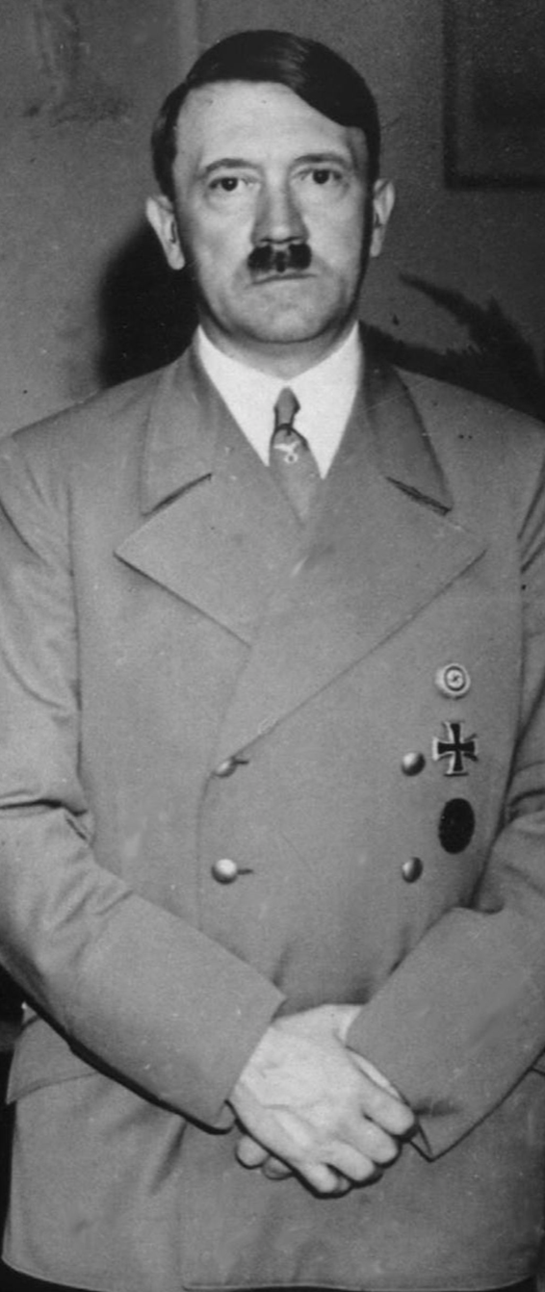

Lecture: 6.3.4. Naziism
Hitler in power popular because of rapid recovery from the Great Depression
The Great Depression in Germany had been the deepest in the world save for the United States
Recovery was fastest save for Japan, and Scandinavia
Hitler in power during peacetime appears to have been focused on boosting employment and building weapons
Not adding to industrial capacity and increasing national wealth
Political effectiveness and military capacity were the priorities.
Political effectiveness we understand: The Nazi movement was still a minority movement. Even at its high point it could command a majority in the Reichstag only with the socialist and communist deputies excluded from the room.
Even then the rump Reichstag was only willing to vote Hitler emergency and dictatorial powers in the panic that followed the “mysterious” burning of the Reichstag.
But weapons? Armies? Hadn’t World War I taught the Germans, and even the Nazis, and even Hitler, not to do that again?
No
2:30 of audio in this slide; 9:00 in this slide group
Notes:
In Germany after World War I, supporters of the German Socialist Party were called Sozis—the first two syllables of Sozialist.
For some reason, urban Bavarians made fun of people named Ignatz: the name was a stand-in for a what in English is a country bumpkin: someone rural, foolish, and awkward.
There was a diminutive nickname for Ignatz: Nazi.
Hence the political enemies of Adolf Hitler and his National Socialist German Workers Party in Bavaria in the 1920s began calling them “Nazis”. The name has stuck.
Once Adolf Hitler had seized power in 1933 and consolidated it in 1934, Hitler was by and large popular. Germany had recovered from the Great Depression relatively rapidly once Hitler had taken power and broken adherence to monetary and fiscal orthodoxy. With the Gestapo in the background to suppress agitation for higher wages, better working conditions, or the right to strike, and with strong demand from the government for public works and military programs, unemployment fell rapidly in Germany in the 1930s. The Great Depression in Germany had been the deepest in the world save for the United States. Recovery was fastest save for Japan, and Scandinavia.
Hitler in power during peacetime appears to have been focused on boosting employment and building weapons, not adding to industrial capacity and increasing national wealth. Build national highways, yes—but build them not by building individual city-to-city or resources-to-industry links, but by building as much as possible first where it would be seen as many as possible.
Political effectiveness and military capacity were the priorities.
Political effectiveness we understand: The Nazi movement was still a minority movement. Even at its high point it could command a majority in the Reichstag only with the socialist and communist deputies excluded from the room. And even then the rump Reichstag was only willing to vote Hitler emergency and dictatorial powers in the panic that followed the “mysterious” burning of the Reichstag.
Hitler and his party did see building more and stronger political support as a priority—hence jobs, and at least the appearance of a government building large infrastructure projects.
But weapons? Armies? Hadn’t World War I taught the Germans, and even the Nazis, and even Hitler, not to do that again?
No

Slide 2
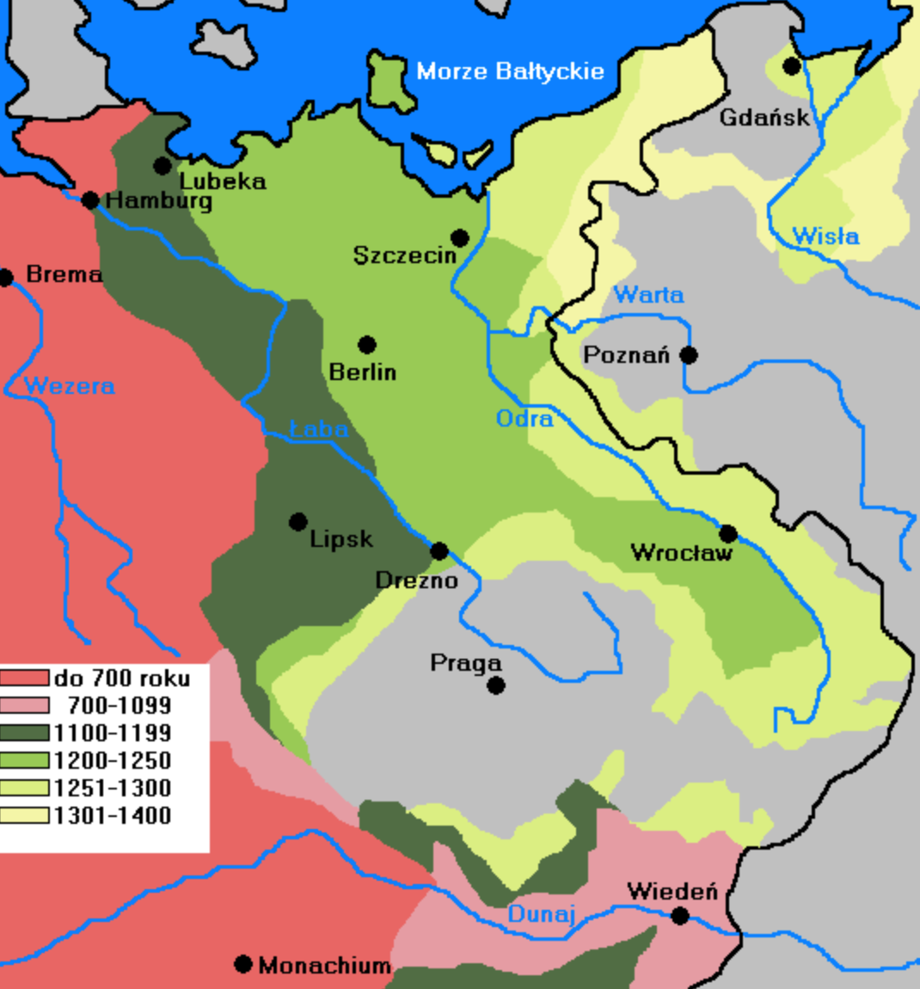
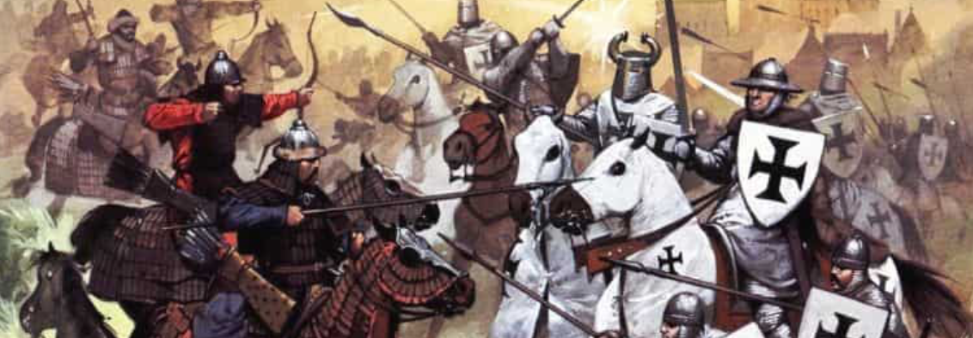
Drang Nach Osten
Hitler took his Malthusianism very seriously indeed
Four ways to support the German population:
Birth control—a non-starter for social darwinist reasons
Mechanize farming—but only a limited and partial cure at best because of diminishing returns
Trade manufactured exports for food—but Britain will never allow that
Take land from Russia
Thus that is the only way to support a German population large enough for Germany to have its rightful place in the world
Do to the Russians what the Americans did to the Amerindians: take their land, divide it up into large, productive farms for migratory settlers, and herd the indigenous population onto reservations
History has taken a hand, and handed domination over Russia over to the Jewish Bolsheviks
“Just kick in the door and the whole rotten structure will collapse…”
4:00 of audio in this slide
Notes:
Adolf Hitler took the turn of the nineteenth century economist Thomas Robert Malthus deadly seriously.
We today know Malthus as the pessimist who gloomily predicted that human populations would outrun their food supply. We know Malthus as somone whose doctrines provided a good description of life before he wrote, but were a bad guide (so far) to subsequent history.
Hitler drew different lessons from Malthus. He began thinking about foreign policy from the premise that:
>Germany has an annual increase in population of nearly nine hundred thousand souls. The difficulty of feeding this army of new citizens must grow greater from year to year and ultimately end in catastrophe.... There were four ways of avoiding so terrible a development…
One way was birth control to reduce population growth, but Hitler saw population restriction as a violation of the principles of social Darwinism and a way to weaken the German race.
A second way was to increase agricultural productivity and farm more land, but Hitler saw this as doomed for the same reason as Malthus did: diminishing returns.
The third way was to purchase food from abroad by “produc[ing] for foreign needs through industry and commerce”; Hitler calls this way relatively “unhealthy” and unrealistic, for Britain would never allow Germany to become the dominant industrial and mercantile power without a fight, and without using all its political resources to discourage German competition with British industries.
What was left? The fourth way was to acquire new soil: a policy of territorial expansion. And Hitler goes on to say:
>We must... coolly and objectively adopt the standpoint that it can certainly not be the intention of Heaven to give one people fifty times as much land and soil in this world as another.... We must not let political boundaries obscure for us the boundaries of internal justice…. The law of self-preservation goes into effect; and what is refused to amicable methods it is up to the fist to take… If land was desired in Europe, it could be obtained by and large only at the expense of Russia, and this meant that the new Reich must again set itself on the march along the road of the Teutonic knights of old, to obtain by the German sword sod for the German plow and daily bread for the nation…
Pre-World War I German foreign policy had gone wrong because it tried to make Germany an industrial and a commercial rather than a territorial power. It had thus built a large battle fleet and so involved itself in a war with Britain on the other side.
Hitler wanted to take a different road, and
>consciously draw a line beneath the foreign policy tendency of our pre-War period. We take up where we broke off six hundred years ago. We stop the endless German movement to the south and west, and turn our gaze toward the land in the east. At long last we break off the colonial and commercial policy of the pre-War period and shift to the soil policy of the future…
But how could Germany expand to the east? Here Hitler was certain that Fate had already lent Germany a hand:
>By handing Russia to Bolshevism, it robbed the Russian nation of that… Germanic nucleus of its upper leading strata. Today... it has been replaced by the Jew.... It is... impossible for the Jew to maintain the mighty empire forever.... The giant empire in the east is ripe for collapse…
All Germany had to do was make sure that it had an army large enough to take advantage, and be prepared for when the collapse would come. As Hitler said in June 1941 when he launched the Nazi armies into Russia: “You only have to kick in the door and the whole rotten structure will come crashing down…”

Slide 3
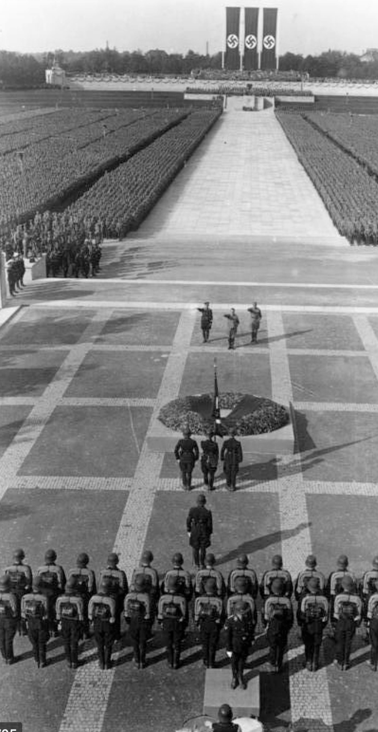
Naziism as Fascism to the Max
A three-part core doctrine:
Antisemitism plus paranoia
Heroic expansionist destiny of the “Aryan” German nation
War as the ultimate test of national worth—social darwinism to the max as well
Plus:
Leadership principle
Terror
National coordination: “Why bother to socialize factories? We socialize human beings!”
Hitler took his Malthusian economics-based Aryan-racial-domination ideology seriously on March 15, 1939, when German tanks rolled (unopposed) into Prague and Germany annexed Czechoslovakia…
50 million people were killed—including six million Jews, 60% of the European Jewish population—by Hitler directly and indirectly in World War II and its surrounding events
Had Hitler won his World War II, that number would have been at least tripled in its aftermath
2:30 of audio in this slide
Notes:
Here we have the core of Nazism:
A very strong dose of German antisemitism (with a paranoid belief in a conspiracy between Jewish financiers who control the capitalist economy and steal from the Germans, Jewish liberal intellectuals who preach humanism and enfeeble the Germans, and Jewish communists who seek to enslave the Germans.
A belief in the German nation and the “aryan” German race as an entity with a special, heroic destiny.
War as the ultimate test of national strength and worth; and (iv) conquest—with extermination or removal of the resident population—to create more “living space” for the German people and larger fields for the German farmers.
Add to this:
the leadership principle—a hatred of parliamentary institutions, and a belief that a good political order sees an inspired leader giving people vision and commands (rather than see parliamentarians haggle and compromise on behalf of interest groups).
the use of terror to obtain obedience, and
the desire to make sure that all of society's organizations serve the national cause.
And you have Nazism.
11.3.2.2. The Core: War and Genocide
Hitler took his Malthusian economics-based Aryan-racial-domination ideology seriously on March 15, 1939, when German tanks rolled (unopposed) into Prague and Germany annexed Czechoslovakia. He took it in dead earnest on September 1, 1939, when German tanks rolled (opposed) across the Polish border, crushed the Polish army in less than three weeks, and began the European phase of World War II. He took it in the most dead earnest of all on June 22, 1941, when German tanks rolled (opposed) across the Soviet border and Germany—still engaged in a brutal war with Britain—took on the Soviet Union as an enemy as well because the entire point of Hitler's foreign policy was the drive to the east: to win bread for the German nation and sod for the German plow by the sword. In so doing he sought and hoped to exterminate, expel, or enslave all the slavic peoples who lived to Germany’s east and stood in the way.
And he took it in dead earnest in the Final Solution to the “Jewish Problem.”
Perhaps 50 million people died in Hitler’s war. But had the Nazis won their war, that number would have been more than tripled.

